Slide 1
Math Circle Orientation
Somerset Elementary School
September 24, 2020

Slide 2
Outline
About Math Circle (MC) at Somerset
Club registration and significant changes
Planned club activities
Family-coach-MC “enhanced” relationship
Competitions
Volunteer roles/jobs

Slide 3
What is Math Circle?
MC is supported by Somerset PTSA. Chairs and Coaches are parent volunteers.
MC is open to 2nd to 5th Graders who love math and wish to participate in Math Competitions

Slide 4
Program Mission
Inspire students’ interests in math and start to appreciate the beauty of it
Enhance classroom performance by developing advanced problem thinking and solving skills
Prepare students for math competitions
I MATH!

Slide 5
REGISTRATION for MC
Registration
September 25th to October 1st
Website (somersetptsa.org)
Registration fee
$50 per team member ($200 per team)
Cover club expenses, training materials, online materials, professional tutoring
Competition fees are NOT included

Slide 6
Significant changes
Personnel changes – new volunteers, welcome!
Three parallel tracks for 2nd – 3rd, 3rd-4th and 5th graders with the goal to firm up their mathematical foundations and get ready for future competition(s). Each track will be led by one or two parent volunteers.
Bi-weekly online Office Hours (thanks, Angela!)

Slide 7
Planned club activities 20-21
3-years of training materials are available to all families who are Somerset PTSA members (including PPT, video, and practice problems)
Professional tutoring for 2nd – 5th graders
Online bi-monthly assessment test to ensure students’ progress
Bi-weekly online Office Hours – 2-hour session

Slide 8
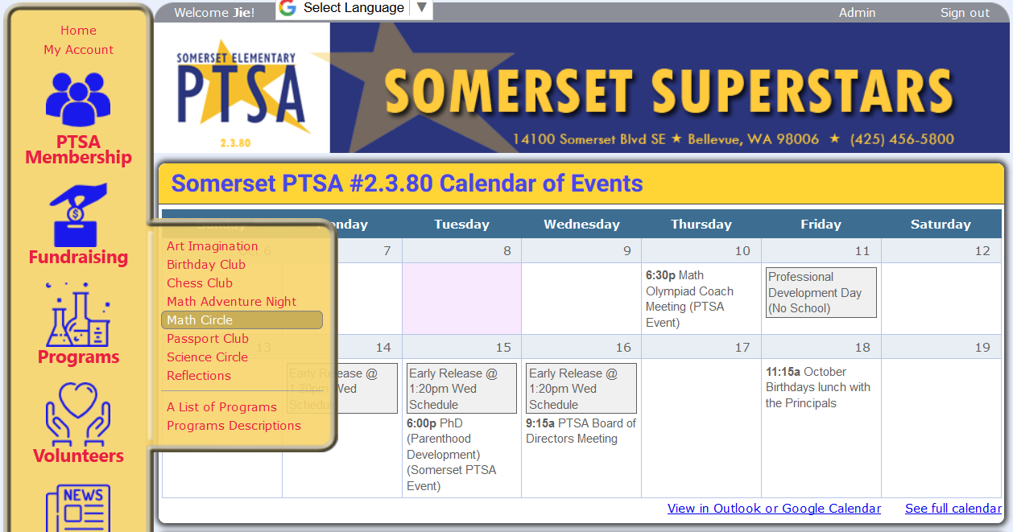
How to access MC website?

Slide 9
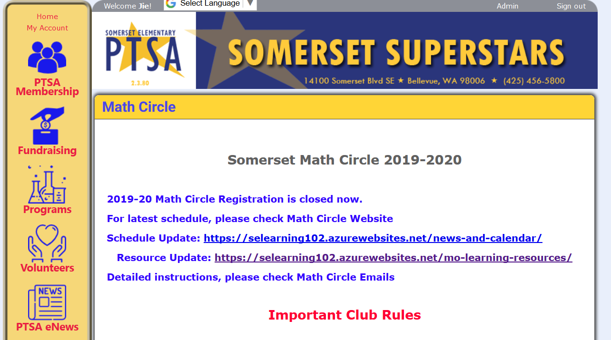
After tonight’s orientation, the MC website will look like this…

Slide 10
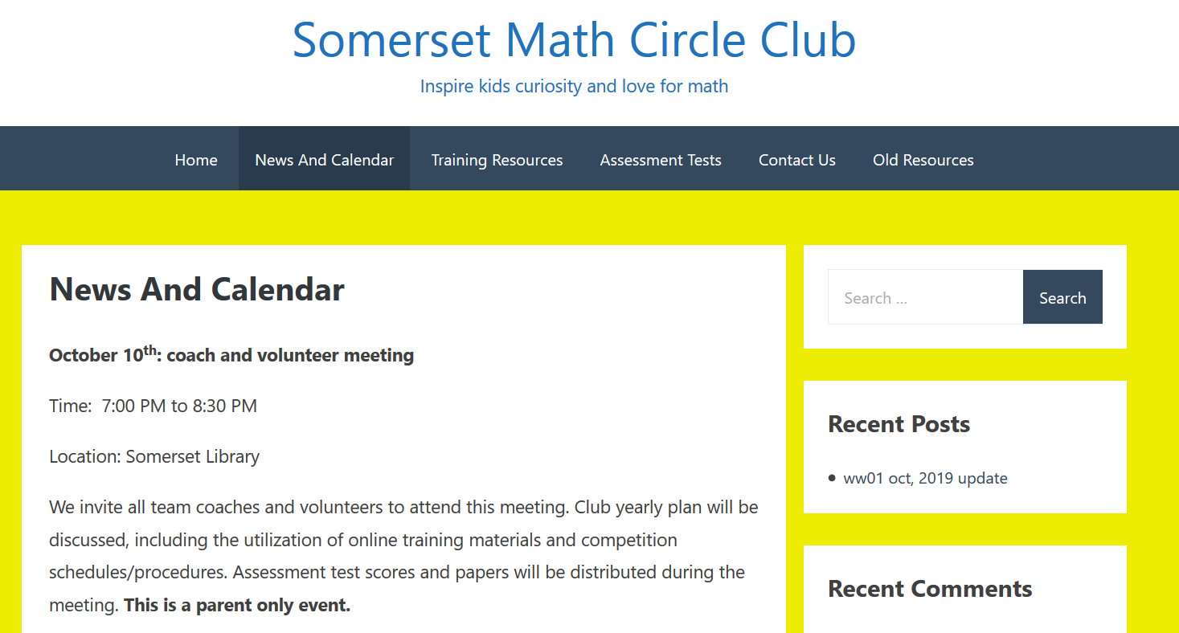
MC main page: important tabs https://selearning102.azurewebsites.net/

Slide 11
Family-coach-MC “enhanced” relationship and realistic expectations
Family-coach expectations
For MC: systematic training (NOT private tutoring service), competition registrations, some progress control through assessment tests
Coach-MC expectations
For families: actively engaging in consistent practice every week and working closely with coaches

Slide 12
Tips for coaching
Know your team’s capability and choose proper pace and materials.
Keep your kids focused and confident.
Encourage kids to write out all steps, go over their process and know where they are making mistakes.
Teach kids how to check their work.
Real test is the most useful practice.

Slide 13
Math Competitions
AMC8
Math Olympiad
Math Kangaroo
WSMC Blaine
Knight of Pi Math Competition
Math is Cool Champion
Notification on competition registrations will be sent through club email and eNews. Watch out!

Slide 14
We NEED YOU!
Coaches
MC curriculum builders (selecting representative examples, practice problems, and challenging practice problems)
Assessment team (select problems for four assessments)
Online instructors (as shown in the video)
Photographers (if you know how to take video using a cell phone, you are well qualified!)

Slide 15
The Math Circle Committee
Joanne Wang - Program Chair
Liping Ke, Katherine Ma, and Jie Yang – Co-Chairs
Liping Ke – Program Advisor
Jie Yang – Program Main Coach
If you want to get involved in our math activities, please contact mo.somerset@gmail.com

